Slide 1
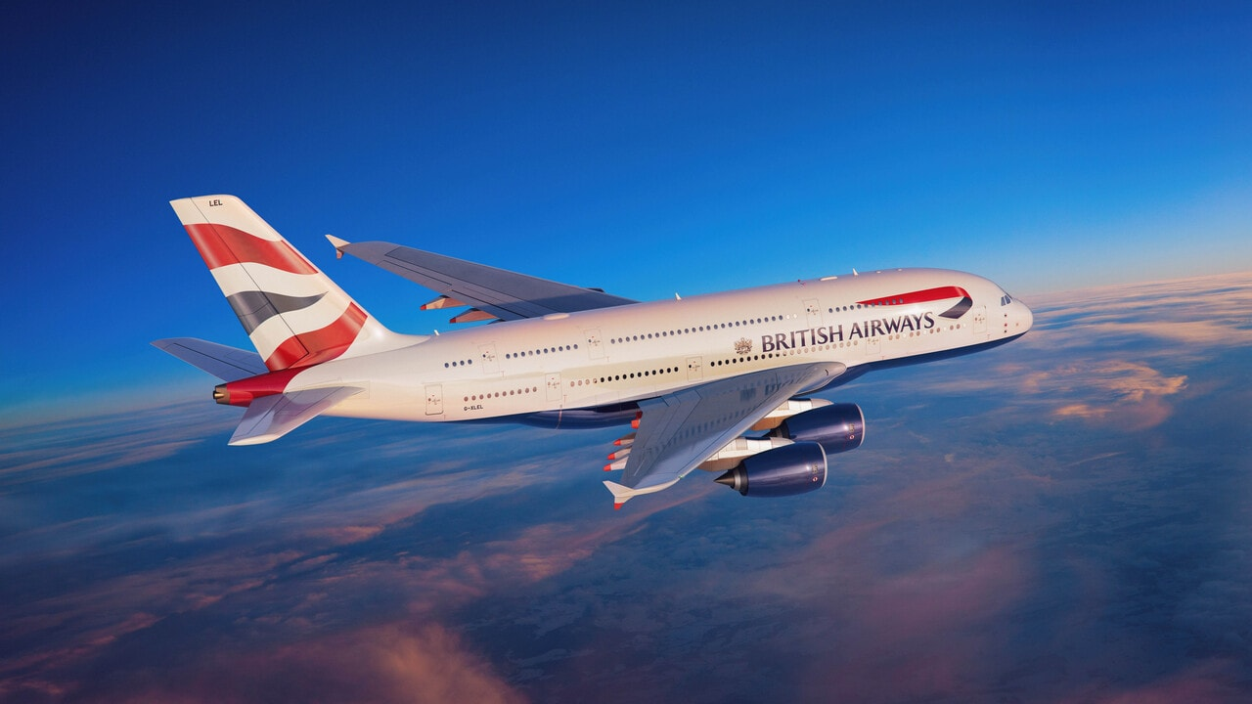
British Airways
Booking Prediction Model Insights
11/09/2024

Slide 2
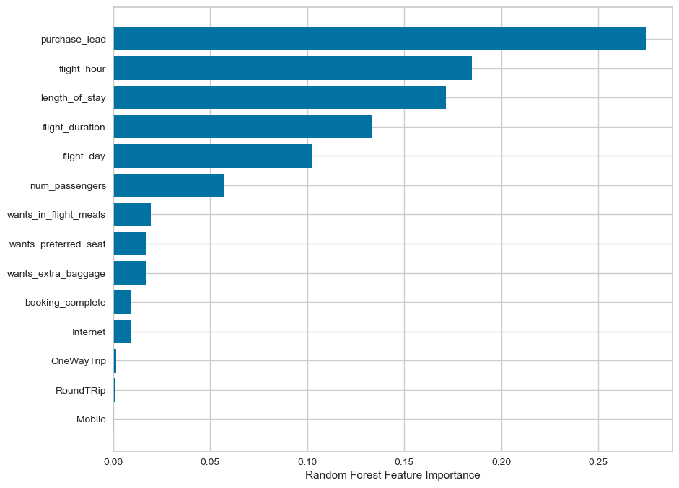
"Predictive Model Insights: Customer Booking Likelihood"
Model Performance Overview:
84% accuracy on test data, effectively identifying
potential non-bookers with 96% specificity helping
to avoid spending on low-potential customers.
Challenges:
Predicting bookings is challenging due to data
imbalance, with fewer actual bookings in the
dataset. The model currently identifies only 10%
of real bookings, so there’s room to improve in
capturing booking opportunities.
Customer Traits & Booking Likelihood:
Customers with shorter booking times or specific preferences are more likely to book.
Strategic Marketing Focus:
Timing: Focus on customers closer to their booking
date.
Personalization: Offer extras like baggage and
meals to increase engagement.

